Slide 1
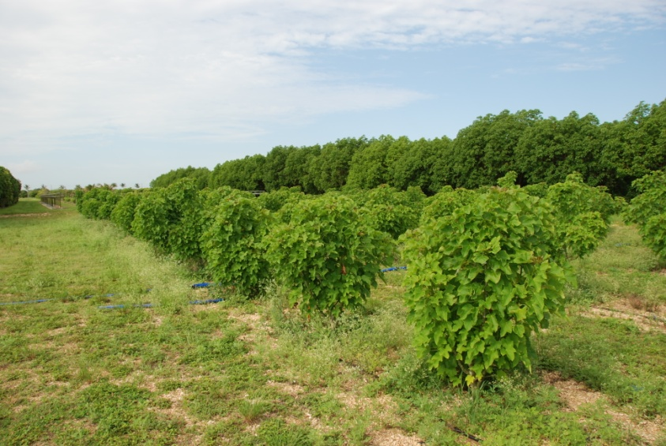
Rwanda BioFuel and Reforestation
WSF
Executive Summary
A unique opportunity to invest in sustainable reforestation producing fuel, food, (cattle) feed, and sequestering carbon with expected ROI of 48% after 5 years. ROI can be used for further sustainable investments.
Bussum, May 2013
Reinier Bosman
Director Project Operations
World Sustainability Fund
info@worldsustainabilityfund.nl
Phone +31-(0)6-2423 5510
* Pic’s are from Jathropa, a similar but different tree

Slide 2
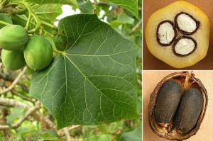
A rare investment opportunity
Second Generation Biodiesel Crop
Financial Summary
50% free land use / 50% Second Generation permanent Biofuel Crop with livestock
Suitable for large scale
Net Energy Return rate of 25
(compare photovoltaic 6.8 and wind 18)
Annual production over 4,000 liters of biofuel per hectare
Annual 48% free operating cash flow after 5 years
31% IRR (Internal Rate of Return)

Slide 3
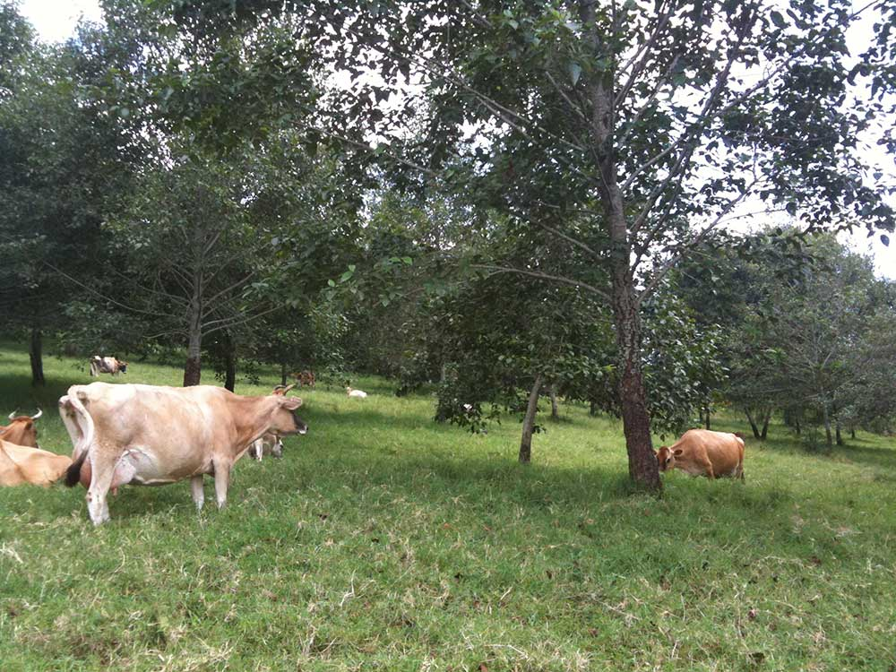
Product Features
Outstanding Financial Performance Offers Opportunities
Product Features
Controls wind and water erosion
CO₂ absorption
Cattle: fixes Nitrogen, auto fertilize
Tree: oil production for fuel (local or as product)
Cattle: food production for humans
Tree: food production for cattle
50% of the land available for other use
2
6
5
4
3
1

Slide 4
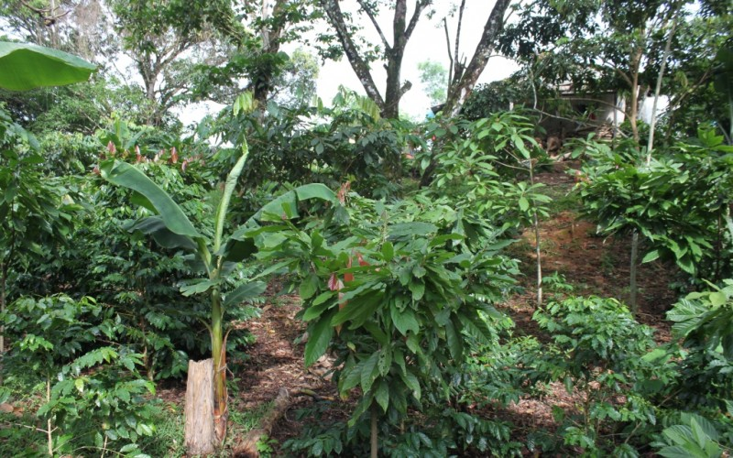
50% of the land is Free for Use
Additional land yield
Options for use of the other 50% land:
Increase functionality or economic profits
Reforestation, erosion prevention
Sustainable Community building, facilities
Food Forest, permaculture
Permaculture nursery, women and men training center
African Sustainability Technology showcase center
International permaculture training center
Agriculture
Additional Biofuel production
Wind or Solar Renewable Energy Farm
Etcetera
WSF offers to help you set this up.

Slide 5
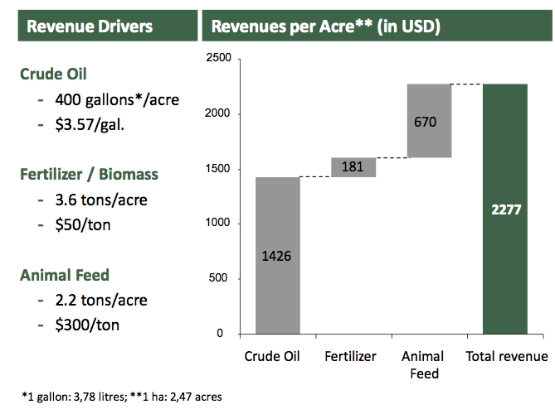
Revenues per acre
10,000 ha plantation in the USA.

Slide 6
Financial returns
Potential for high annual returns
10,000 ha plantation in the USA.
Annual ROI can be used for further investment in Sustainability

Slide 7
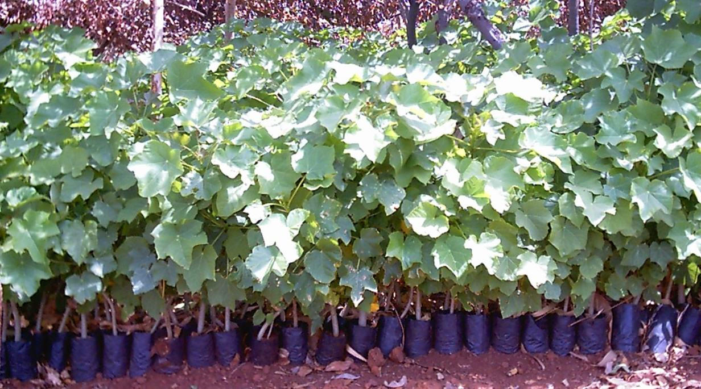
Potential growth range
Expected succesful plantation
Growth area of the tree
The tree is native to India and Australia.
Between 30 degrees North and South of the Equator, in areas consistent with the Holdridge Zones previously identified “Mediterranean climates”.
With known citrus production North and South of 30 degrees (e.g. Arizona, California, Southern Spain, Italy, Greece and Turkey).

Slide 8
Biofuel Tree Characteristics
Proven track record in India, Australia, US
First yield after 3 years
Up to 100 years of life time
Extensive on-going R&D
Not an invasive weed threat
Highest return on marginal soils
Drought tolerant
Highly salt tolerant
Sellable by-products
Net sequestring of Carbon
Mechanical harvesting
Direct use of oil
Cost effective refining
High quality Biodiesel
Cost effective broad hectare solution
Livestock with higher stocking rates
Better quality pastures
Suitable for inter-row cropping
High annual seed yield (10-20,000 seed per tree)
High (35-43%) oil content in seed
Salinity tolerance up to 2000ppm (eq to saltbush)
Elite germplasm has been identified
clonally propagated
Deep tap root sources water and nutrients well down in subsoil
Produces its own nitrogen thereby displacing approximately $200 per hectare/pa of nitrates applied as compound fertilizer
Fungicidal & insecticidal action decreases pest attack, natural pesticide>DDT

Slide 9
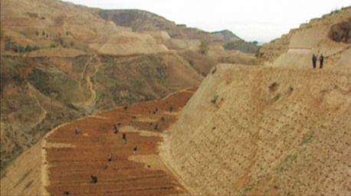
WSF services
how can WSF support you
The World Sustainability Fund offers services
to catalyze Global Sustainability initiatives
Finding finances for sustainability initiatives
Consultancy for loans and knowledge
Access to many State of the Art⁺ green technologies
Advising in constructions and consortium partners for sustainability initiatives
Project execution and jobs as much as possible by locals
Global roll-out of successful sustainability initiatives
The Löss plateau, China, before reforestation

Slide 10
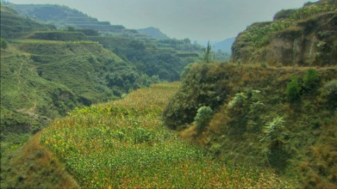
WSF offers
WSF, partner in Sustainability
The World Sustainability Fund offers a Strategy and Toolkit
To realize Sustainability and empower Local Population
with Unprecedented Economic Profits
Investments earned back in 5-8 years
Project start-up based on interest-free loans
World-wide network of green investors and industry
Highly connected with UN and global level decisionmakers
Experienced in highly accelerated global roll-out
Unprecedented highly economically profitable
green projects
The Löss plateau, China, after reforestation

Slide 11
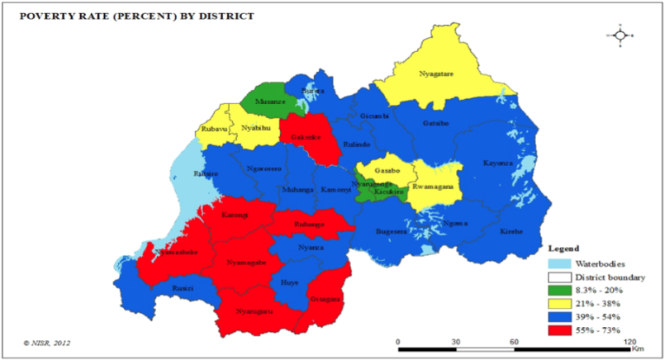
Opportunities for Rwandan Reforestation
Interconnections, jobs, food, private sector, skills, green economy, carbon, erosion, financial flow
Opportunities for Rwanda Reforestation
Biofuel is 100% carbon neutral renewable energy source for own use or export
Build a refinery for the biofuel production (WSF): jobs
Train locals in sustainable agroforest farming and permaculture
Provide farming jobs to locals, start in blue/red poorest province(s)
Establish African Sustainability Technology Showcase Center
Establish African Permaculture Knowledge Training Center
Train women in permaculture skills at no cost Locals and internationals alike pay for the course with labour so nursery and tree planting could be at low costs
Use economic profits to further finance sustainabiility projects: safe drinkwater, roll these concepts out in Rwanda, etcetera
WSF offers to help set this up.

Slide 12
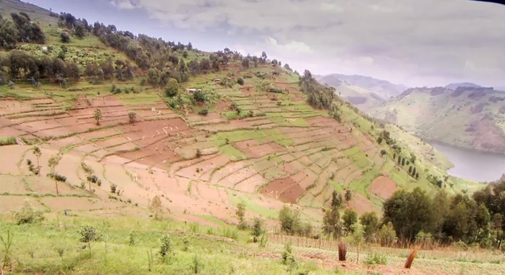
Rwanda Implementation Proposal
Possible timeline framework
June
June 30
July 19
July 20
Sept-Oct
What we Offer, Milestones, what we Need
WSF and John Liu to visit Rwanda to discuss plan
WSF writes application for UN CDM loan scheme to generate PDD for Rwanda Reforestation
signature Rwanda to start reforestation project (100 / 500 / 10,000 ha as desired)
WSF applies for CDM loan scheme Rwanda
UN approves CDM interest-free loan scheme
WSF, Rwanda, determine project location. Skypes with Rwanda to consider starting of Training center, to start permaculture soil production and tree nursery and write training center further plans
WSF writes PDD, obtains UN Carbon certiciation, finds investor $50 mio to finance 10,000+ ha planting

Slide 13
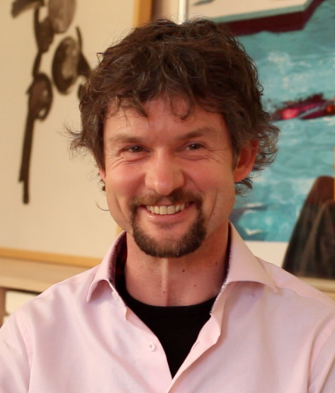
WSF is at your Service
Further information
How can you find us?
For further information and inquires please contact:
Reinier Bosman
Reforestation and Project Operations
World Sustainability Fund
info@worldsustainabilityfund.nl
Phone +31-(0)6-2423 5510
Skype ID rebosman

